Slide 1


PRINCIPAL
MR. VILAS U. SHEJUL
G.S.S.Sr.COLLEG MAJIWADE THANE
N.S.S.
UNIT NO. D-06
PROGRAM OFFICER
MISS.RUKSANA SHAIKH
PRESENTING ANNUAL REPORT
2023-2024

Slide 2


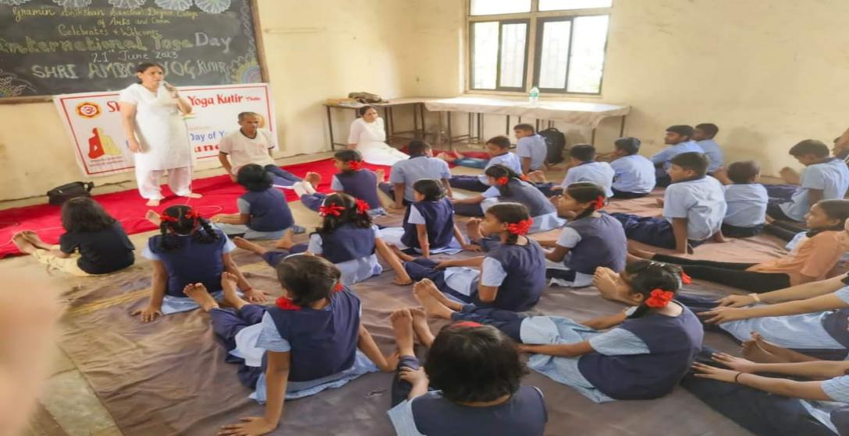
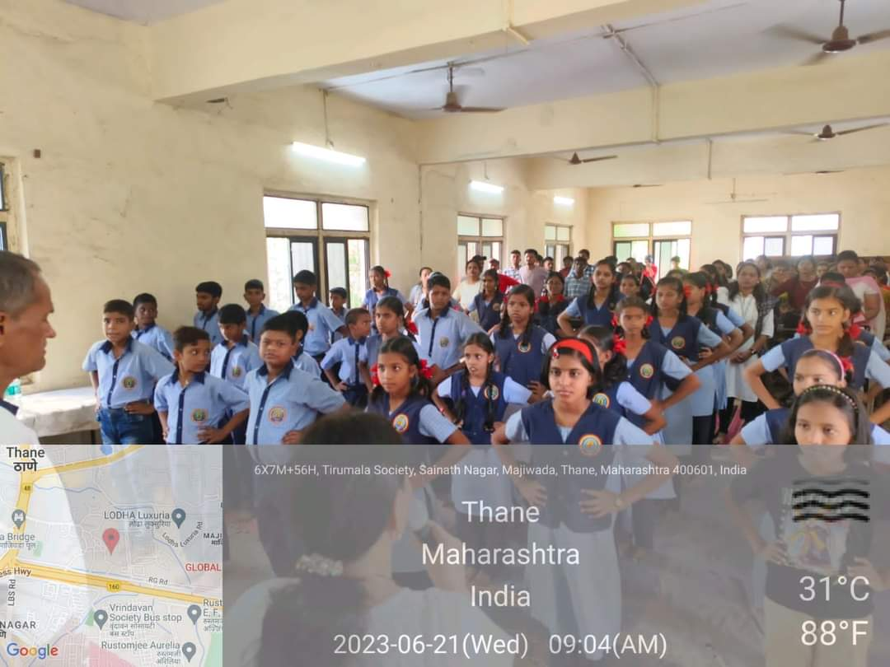
GRAMIN SHIKSHAN SHANSTHA’S DEGREE COLLAGE MAJIWADE, THANE
INTERNATIONAL YOGA DAY
21 JUNE 2023-24
Total Volunteers | No.of Work Hours | No. of Benificiaries if any
56 | 3 | 200
N.S.S P.O- MISS. RUKSANA SHAIKH PRINCIPAL- VILAS SHEJUL

Slide 3
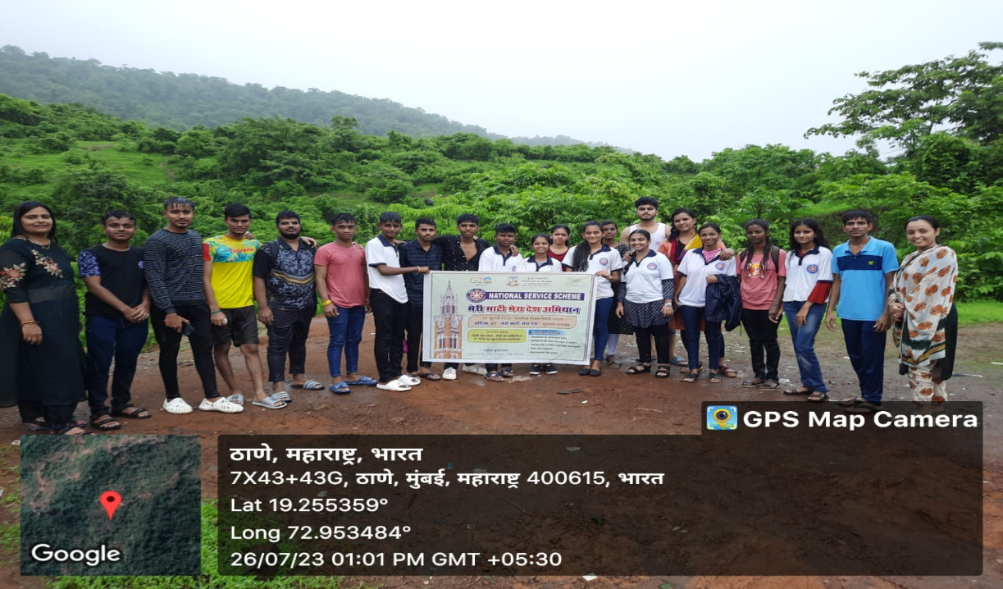

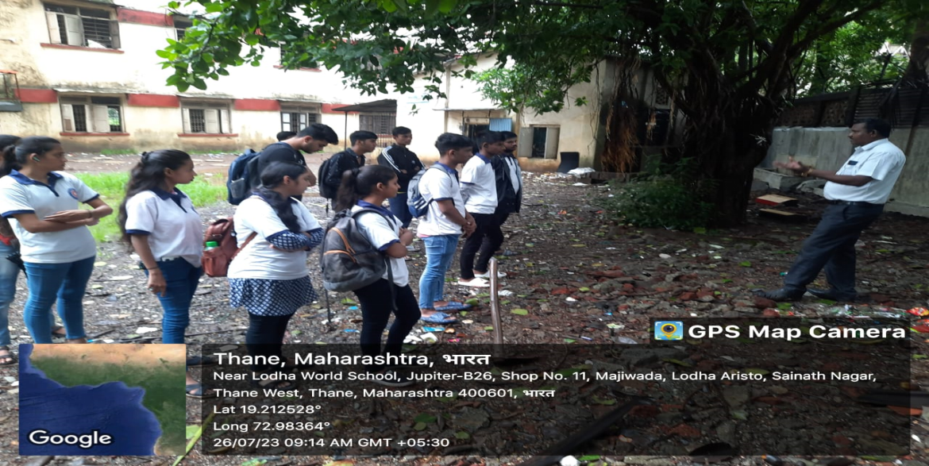
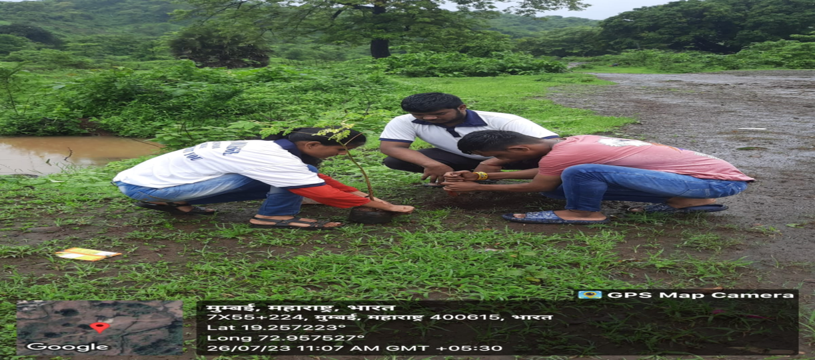
MERI MITTI MERA DESH
PLANTATION MISSION
27 JULY 2023-24
Total Volunteers | No.of Work Hours | No. of Benificiaries if any
45 | 3 | 200

Slide 4

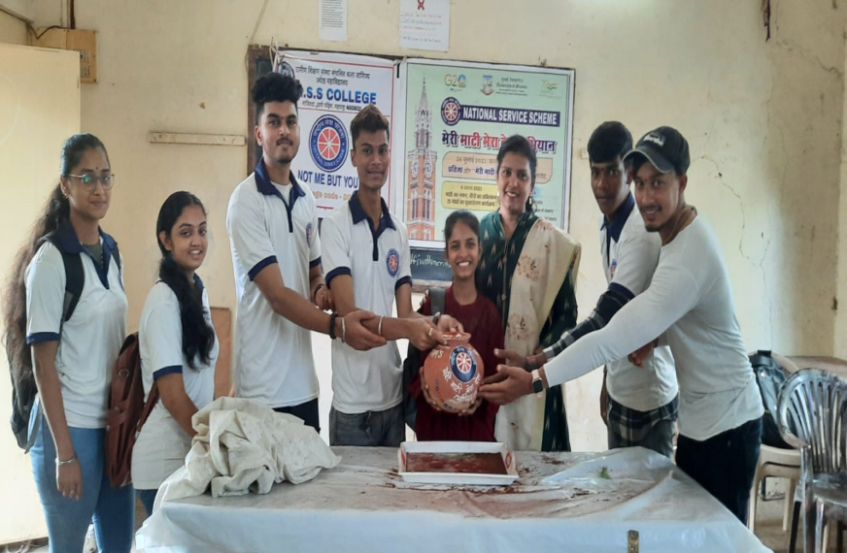
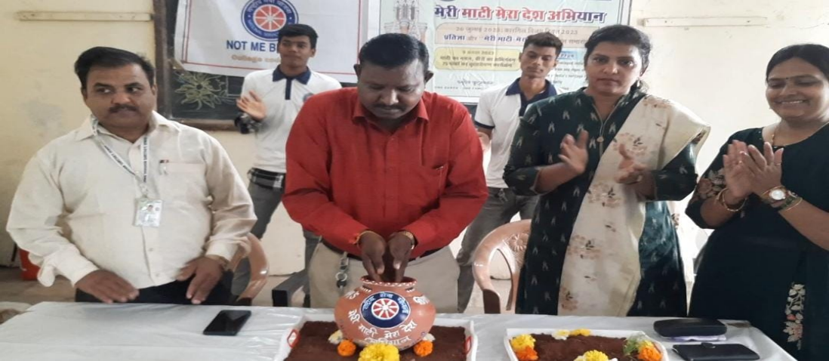
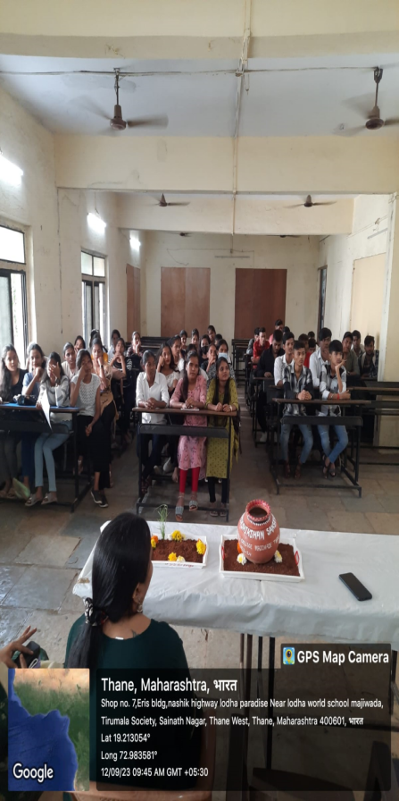
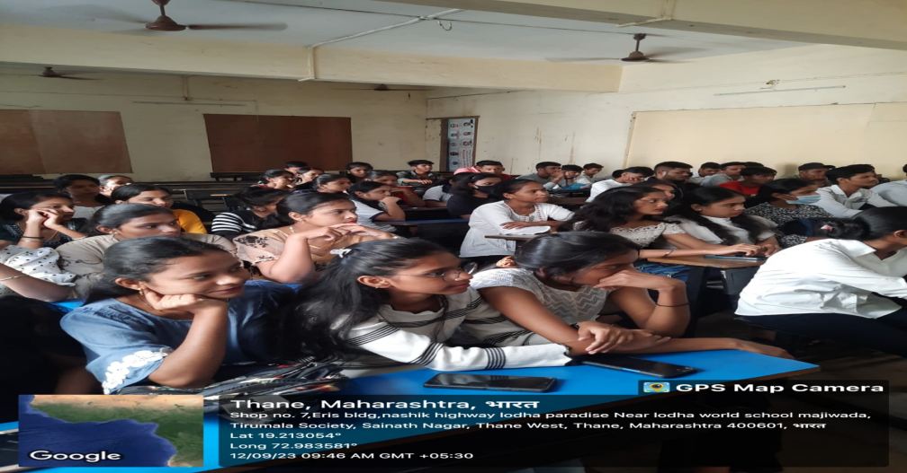
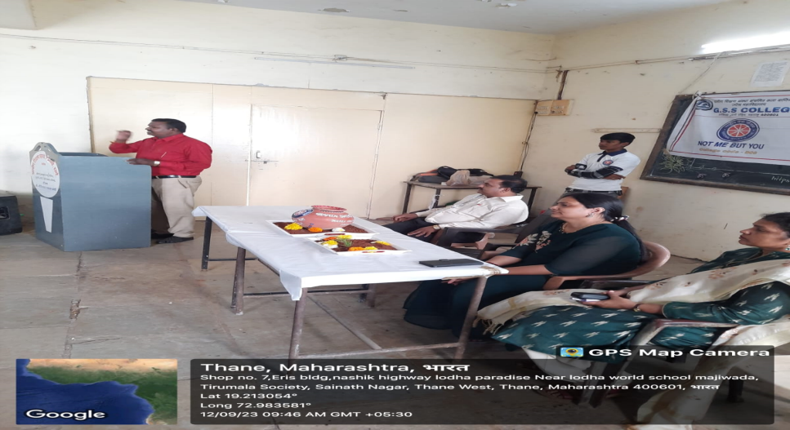
KALAS ABHIYAN (MERI MATI MERA DESH) 2023-24
Total Volunteers | No.Of Work Hours | No.of Benificiaries if any
70 | 2 | 400

Slide 5

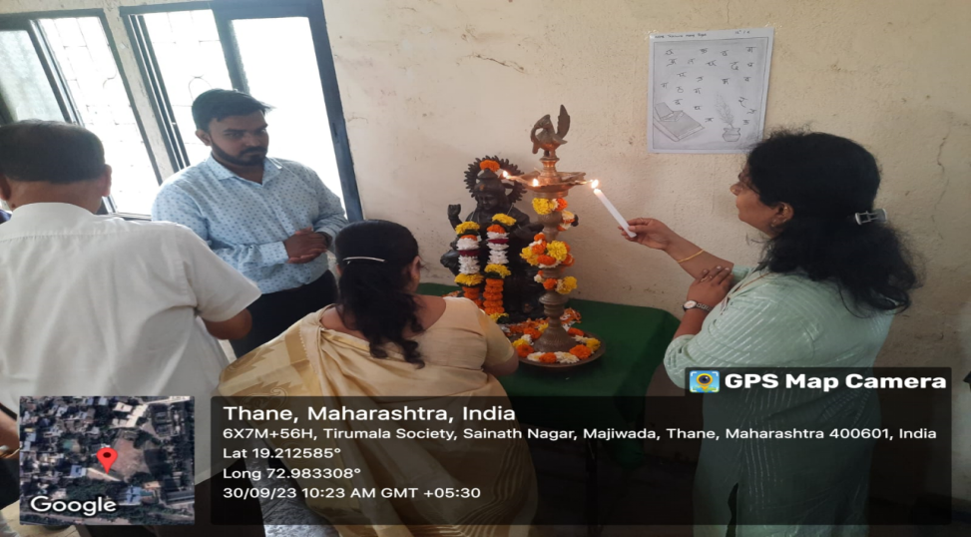
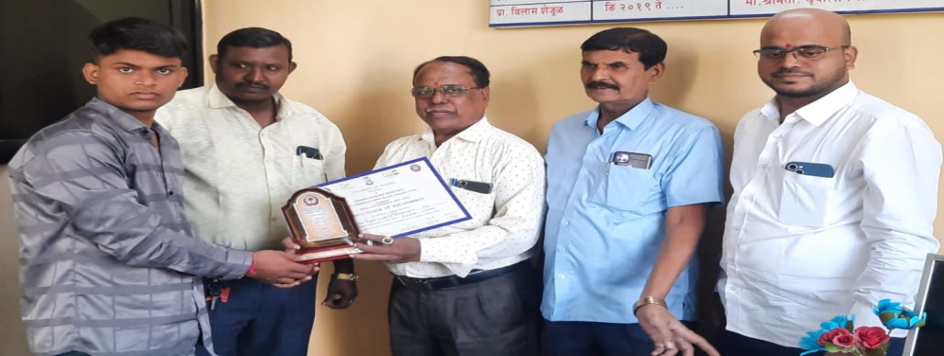
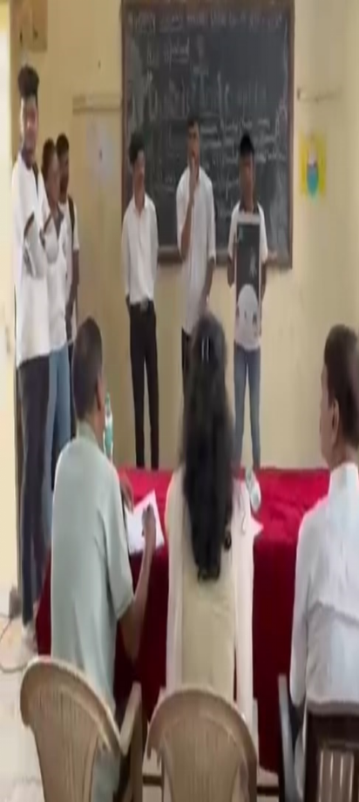
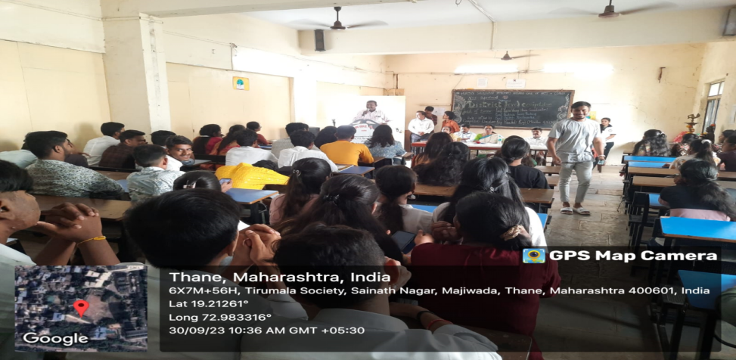
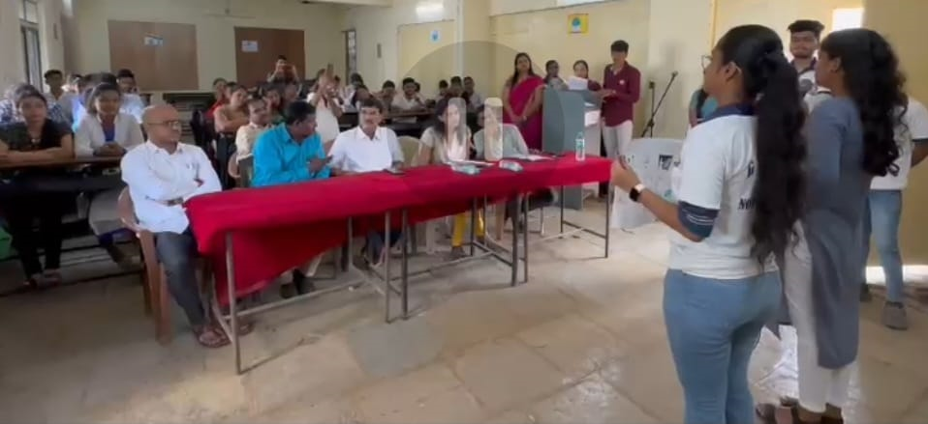
DISTRICT LEVEL COMPETITION 30 AUG 23 TO 5 SEP 2023-24
Total Volunteers | No. of WorK Hours | No.of Benificiaries if any
70 | 3 | 400

Slide 6

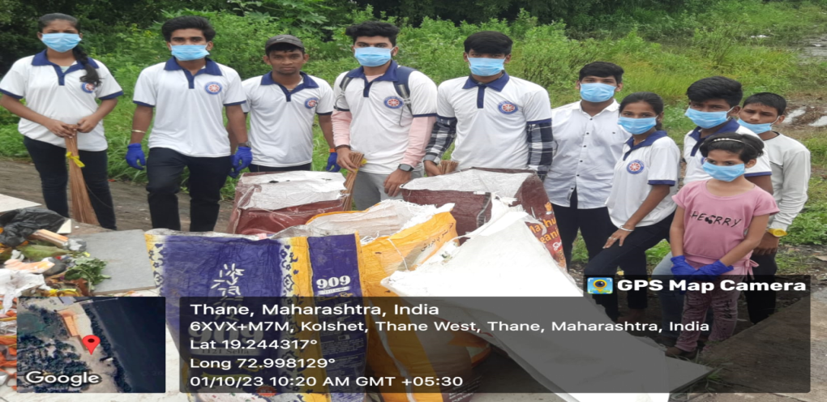
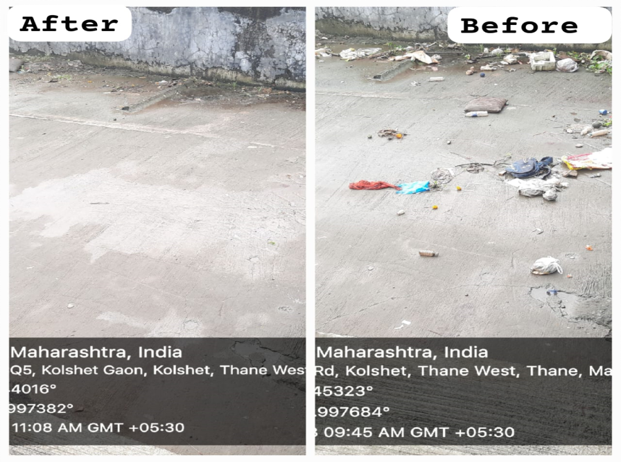
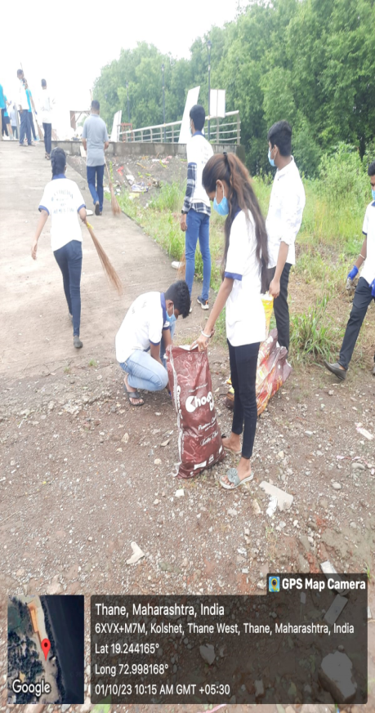
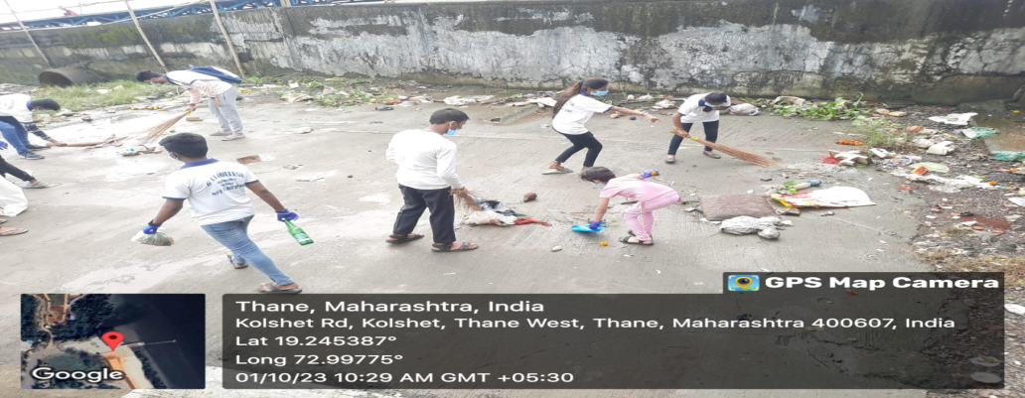
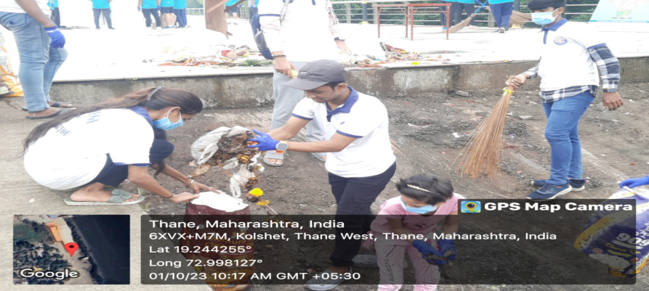
BHARAT SWACCHTA ABHIYAN KOLSHET KHADI 01 OCT 2023 - 24
Total Volunteers | No. of WorK Hours | No. of Benificiaries if any
40 | 3 | 1000

Slide 7

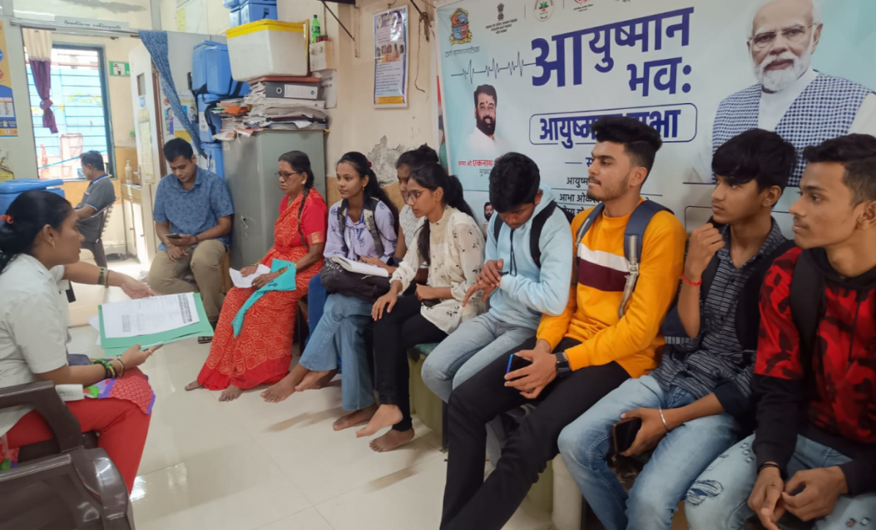
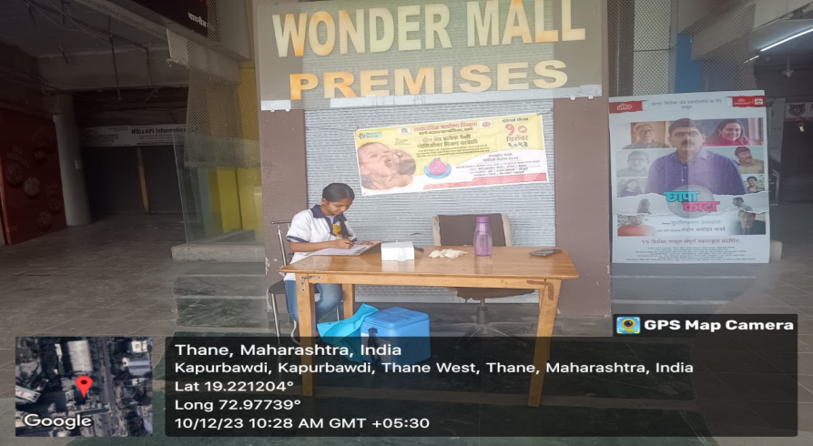
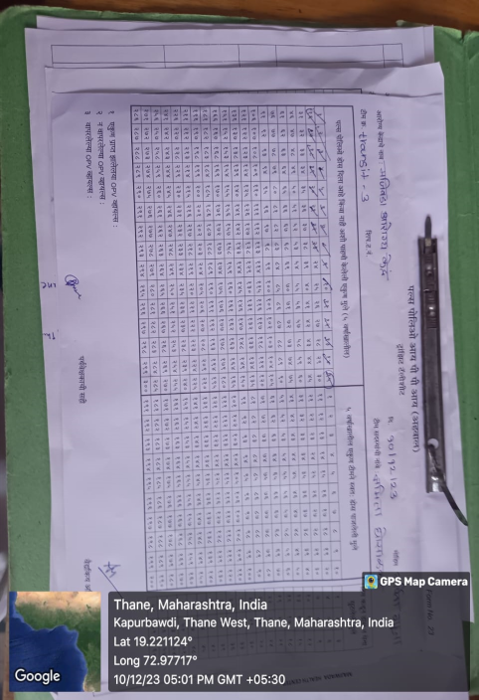
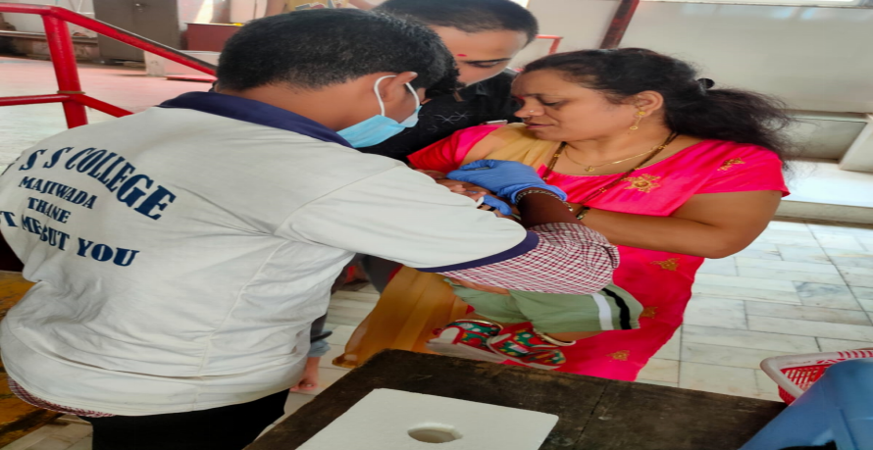
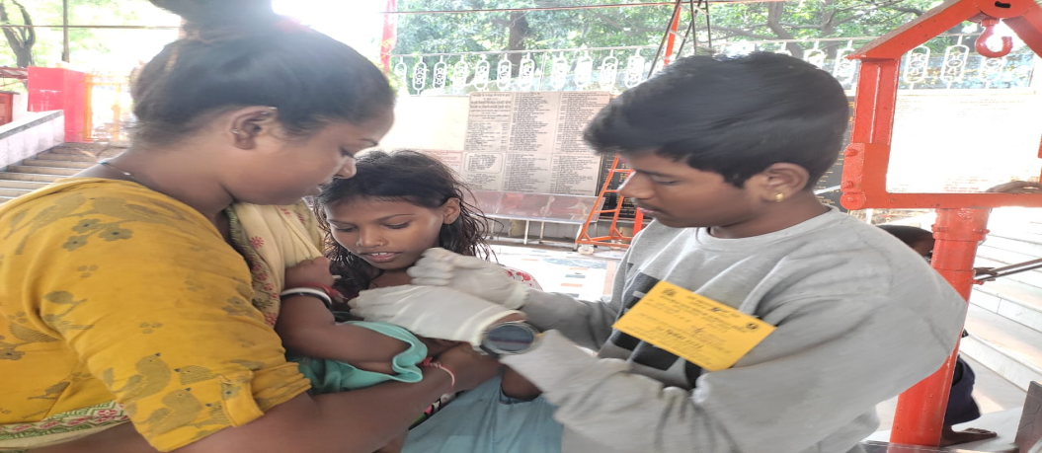
POLIO VECILATION 10 DEC 2023-24
Total Volunteers | No. of WorK Hours | No. of Benificiaries if any
30 | 4 | 200

Slide 8


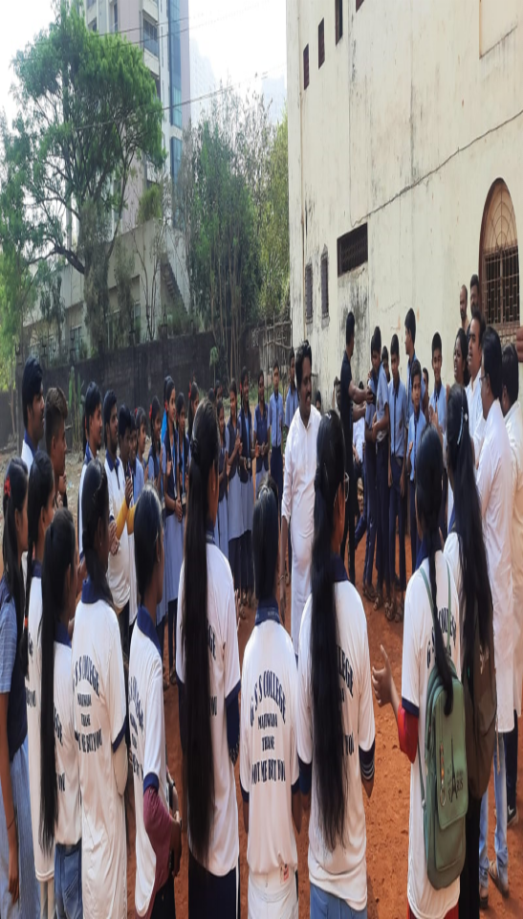
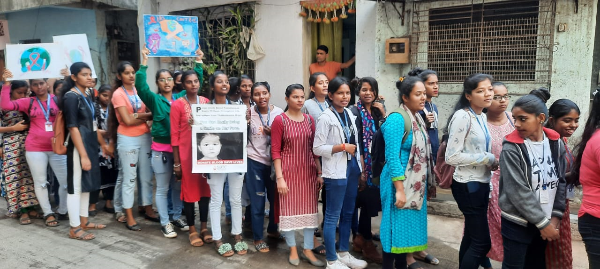
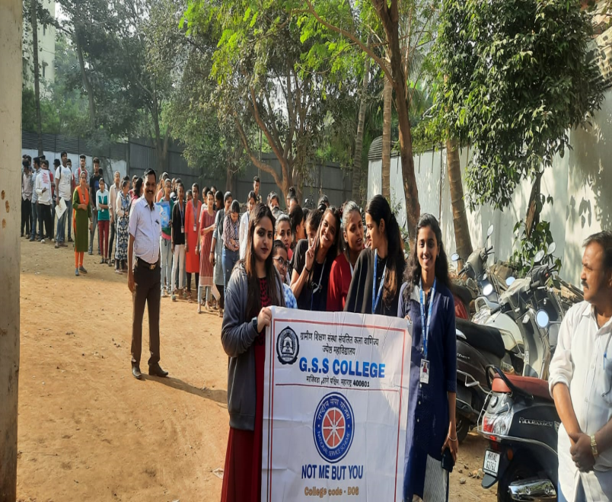
WORLD AIDS DAY 1 Dec 2023-24
Total Volunteers | No. of WorK Hours | No.of Benificiaries if any
80 | 4 | 700

Slide 9

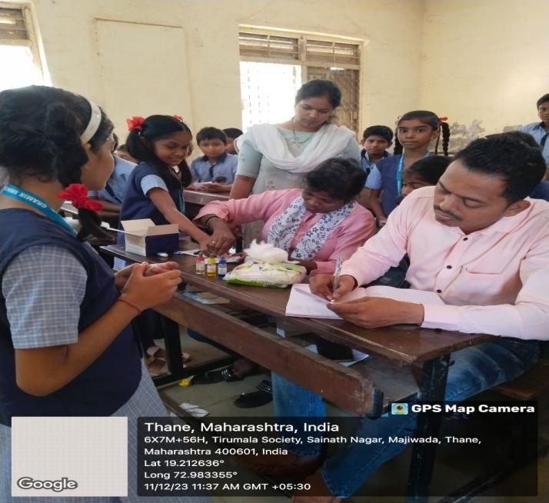
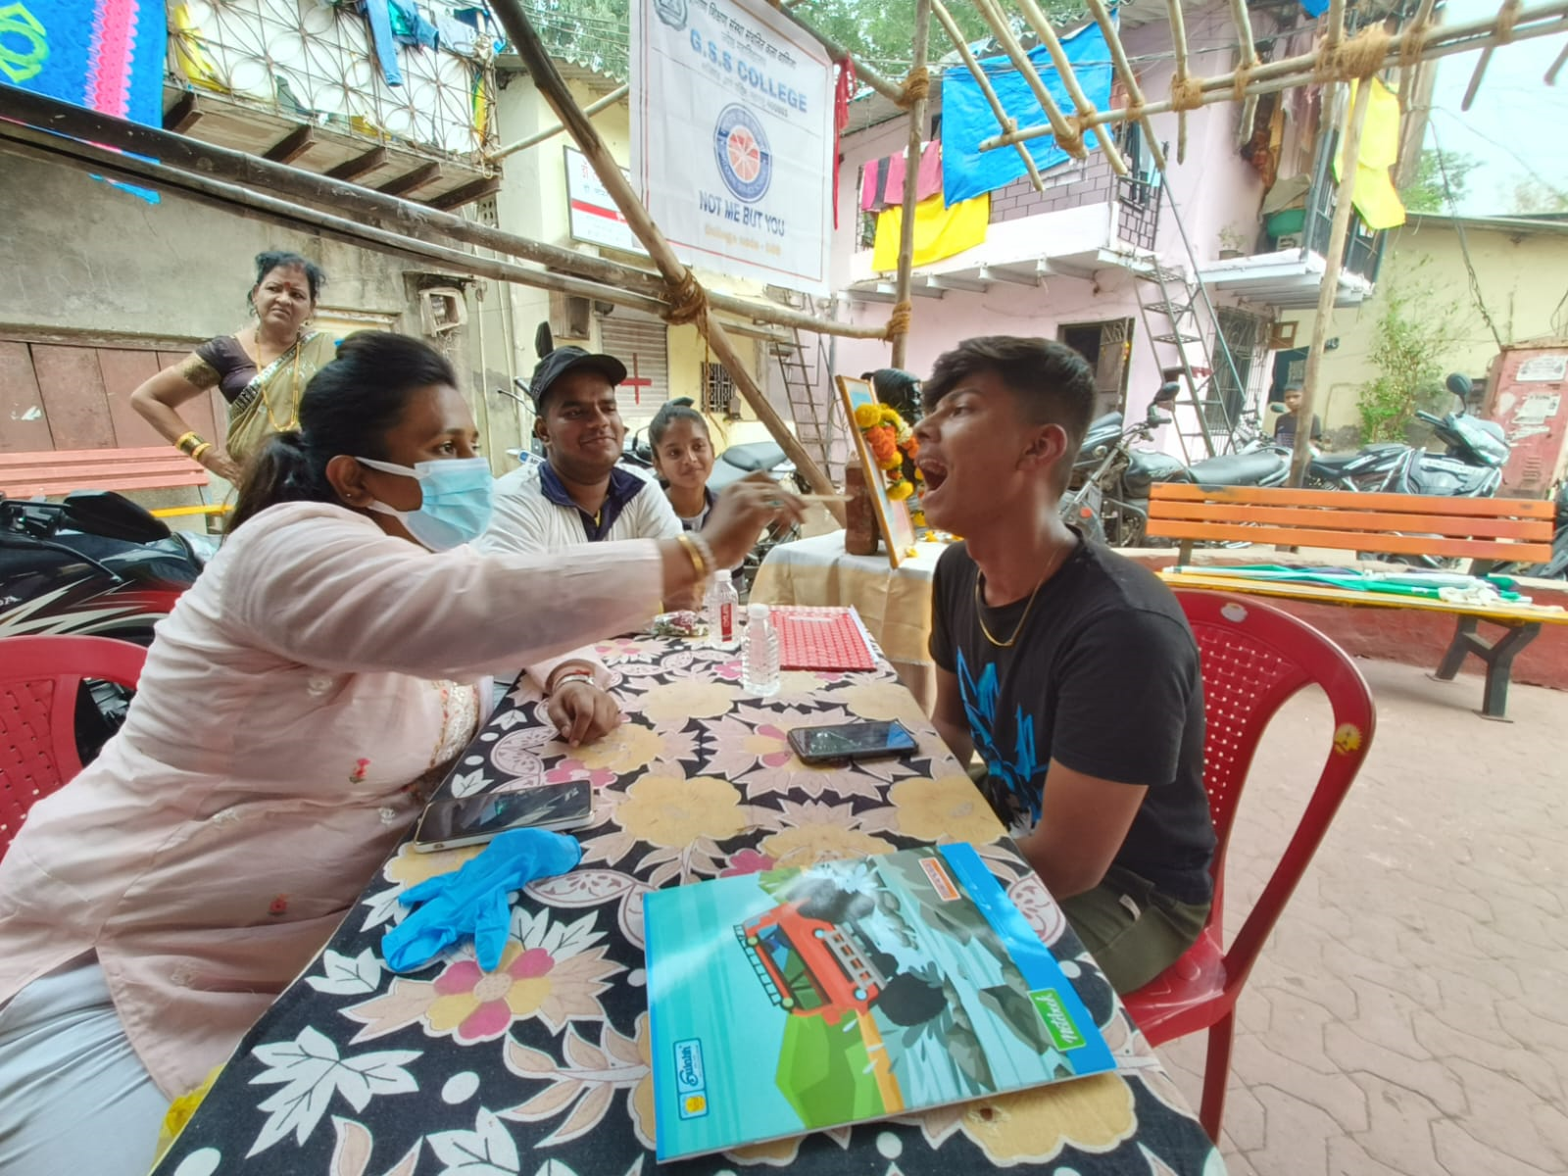
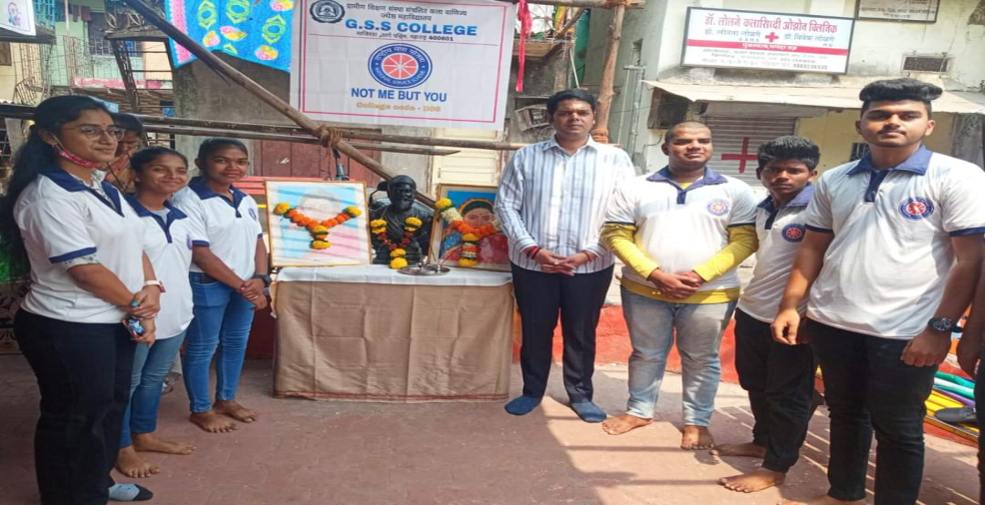
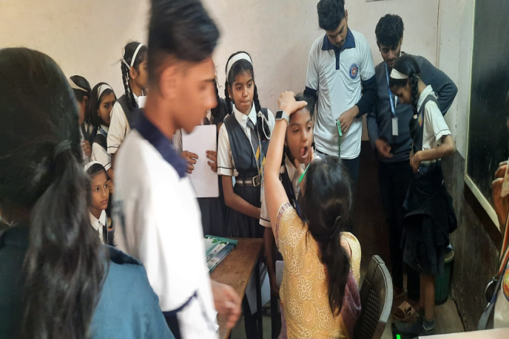
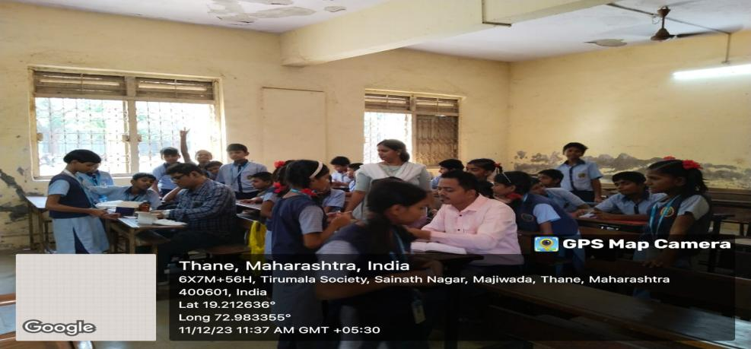
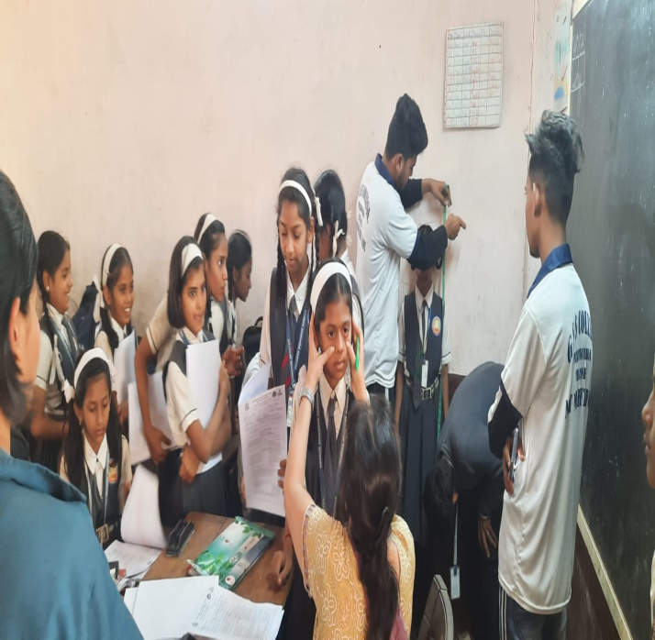
HELTH CHECK- UP CAMP 11 DEC 2023-24
Total Volunteers | No. of WorK Hours | No. of Benificiaries if any
40 | 4 | 400

Slide 10
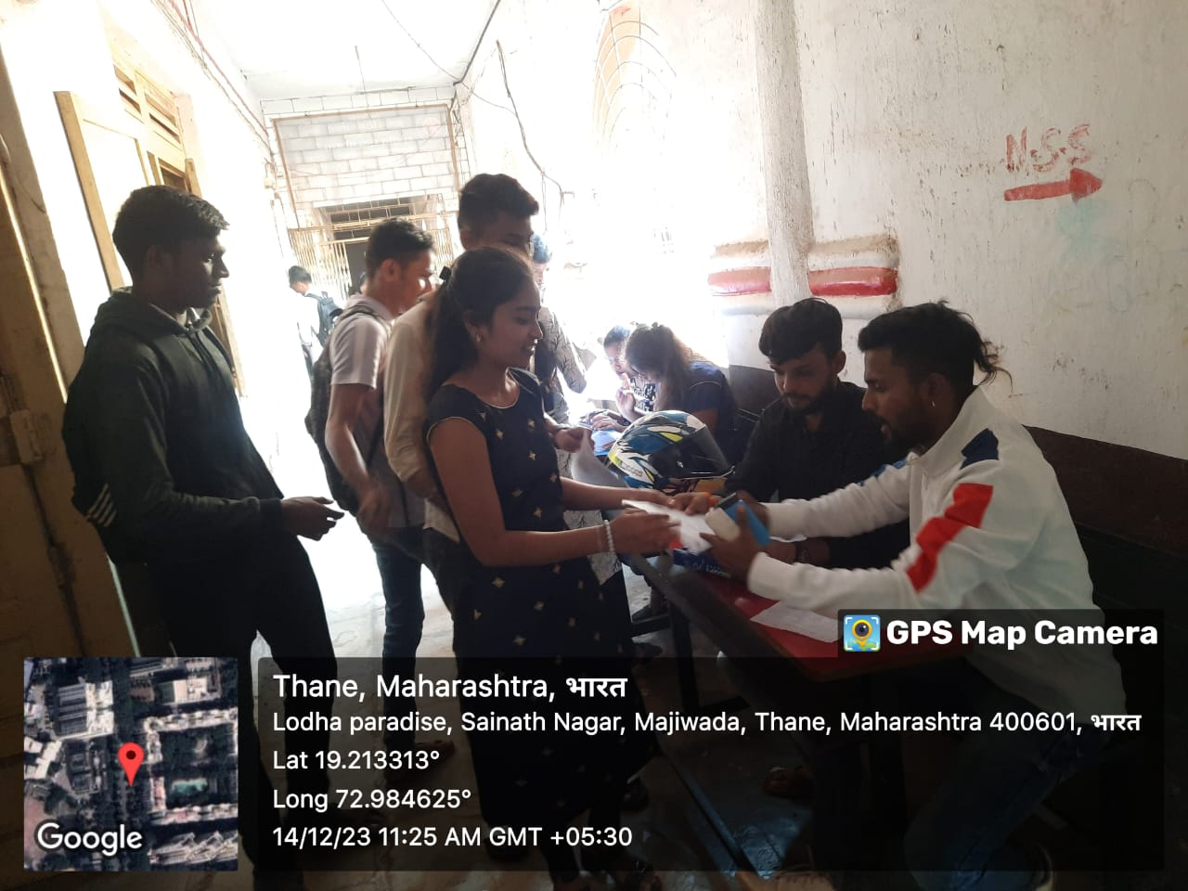
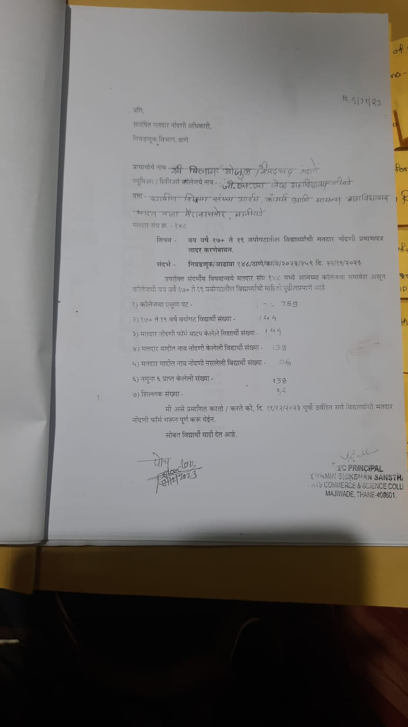
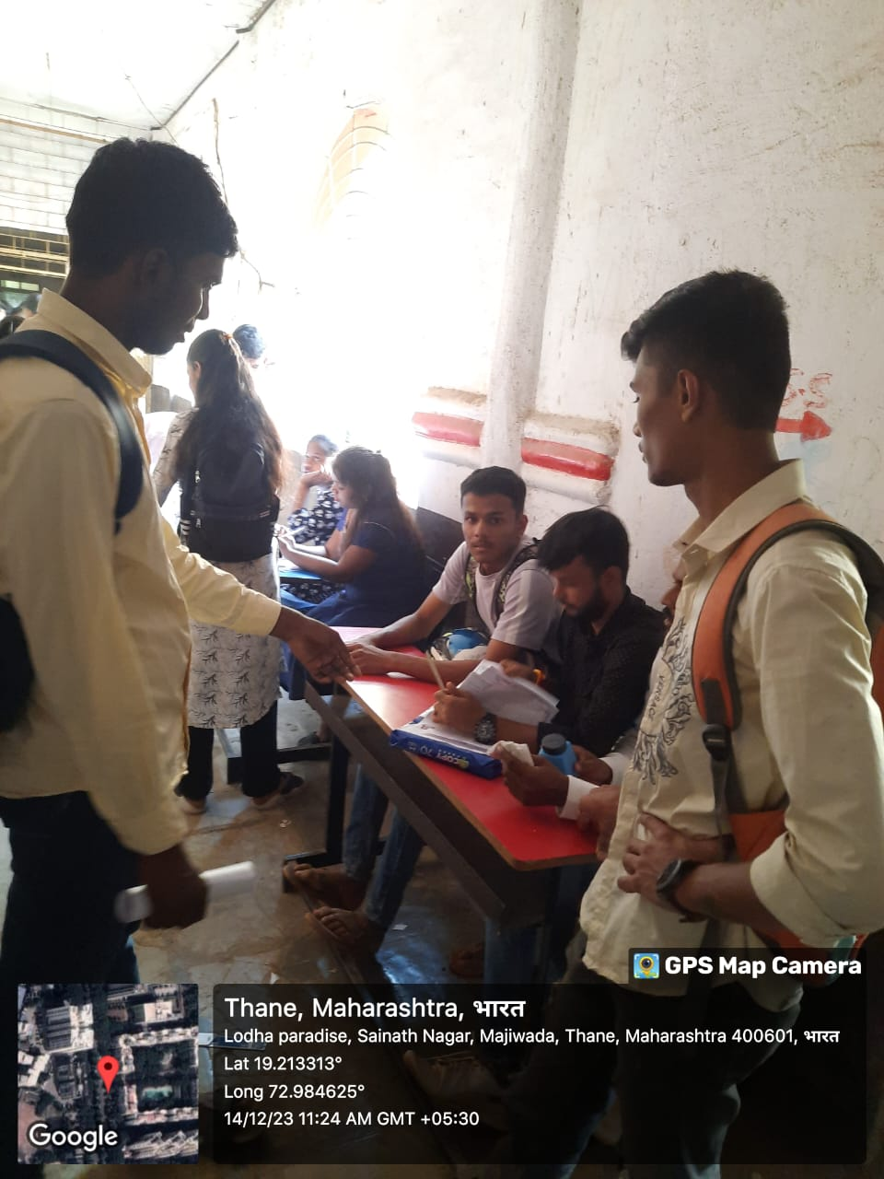
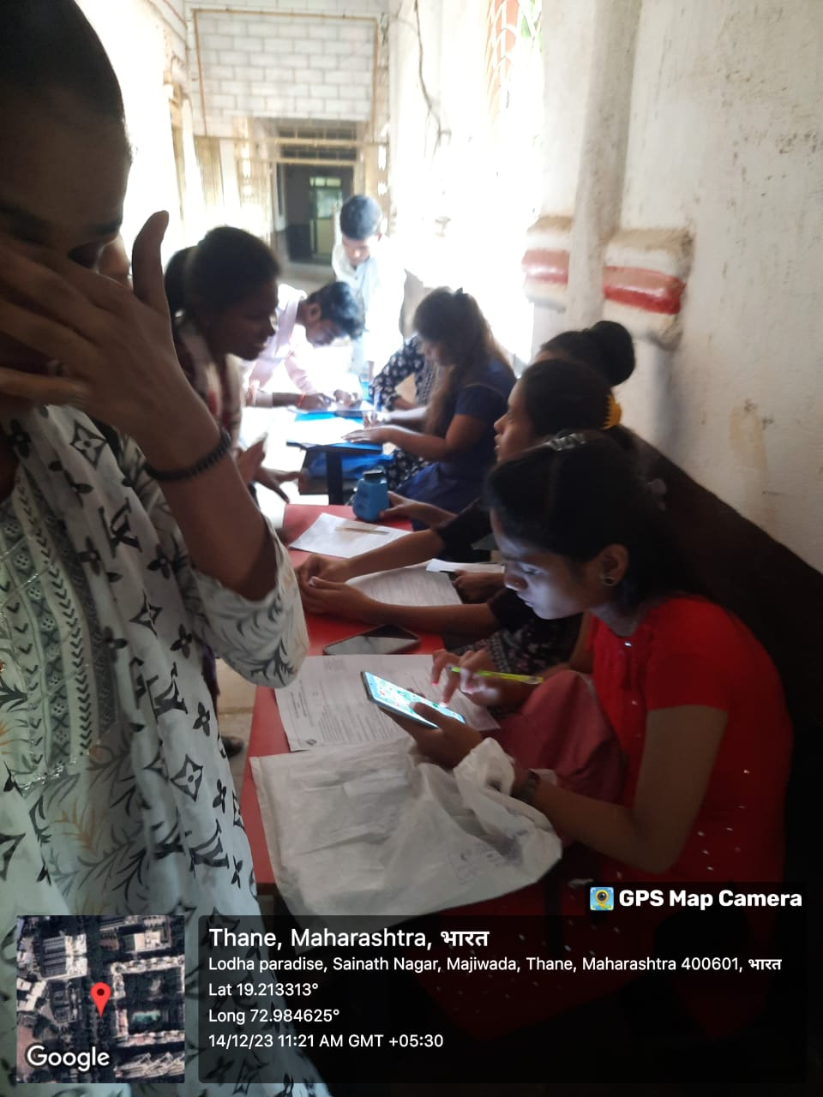
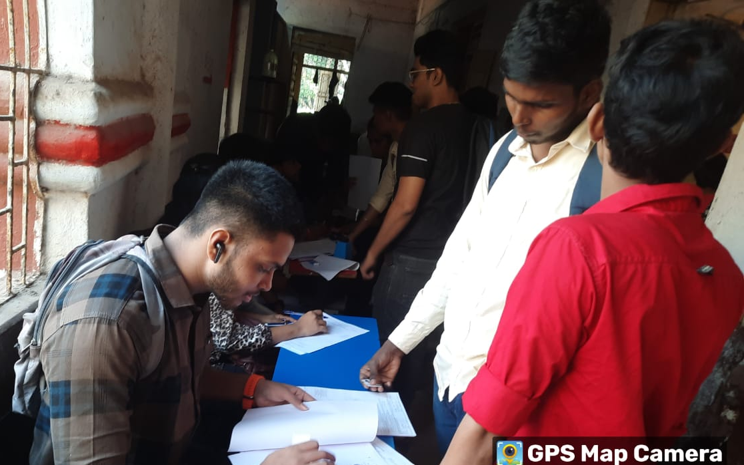
VOTER REGISTRAION CAMPAIGN 11 DEC 2023-24
Total Volunteers | No. of WorK Hours | No. of Benificiaries if any
25 | 4 | 138

Slide 11
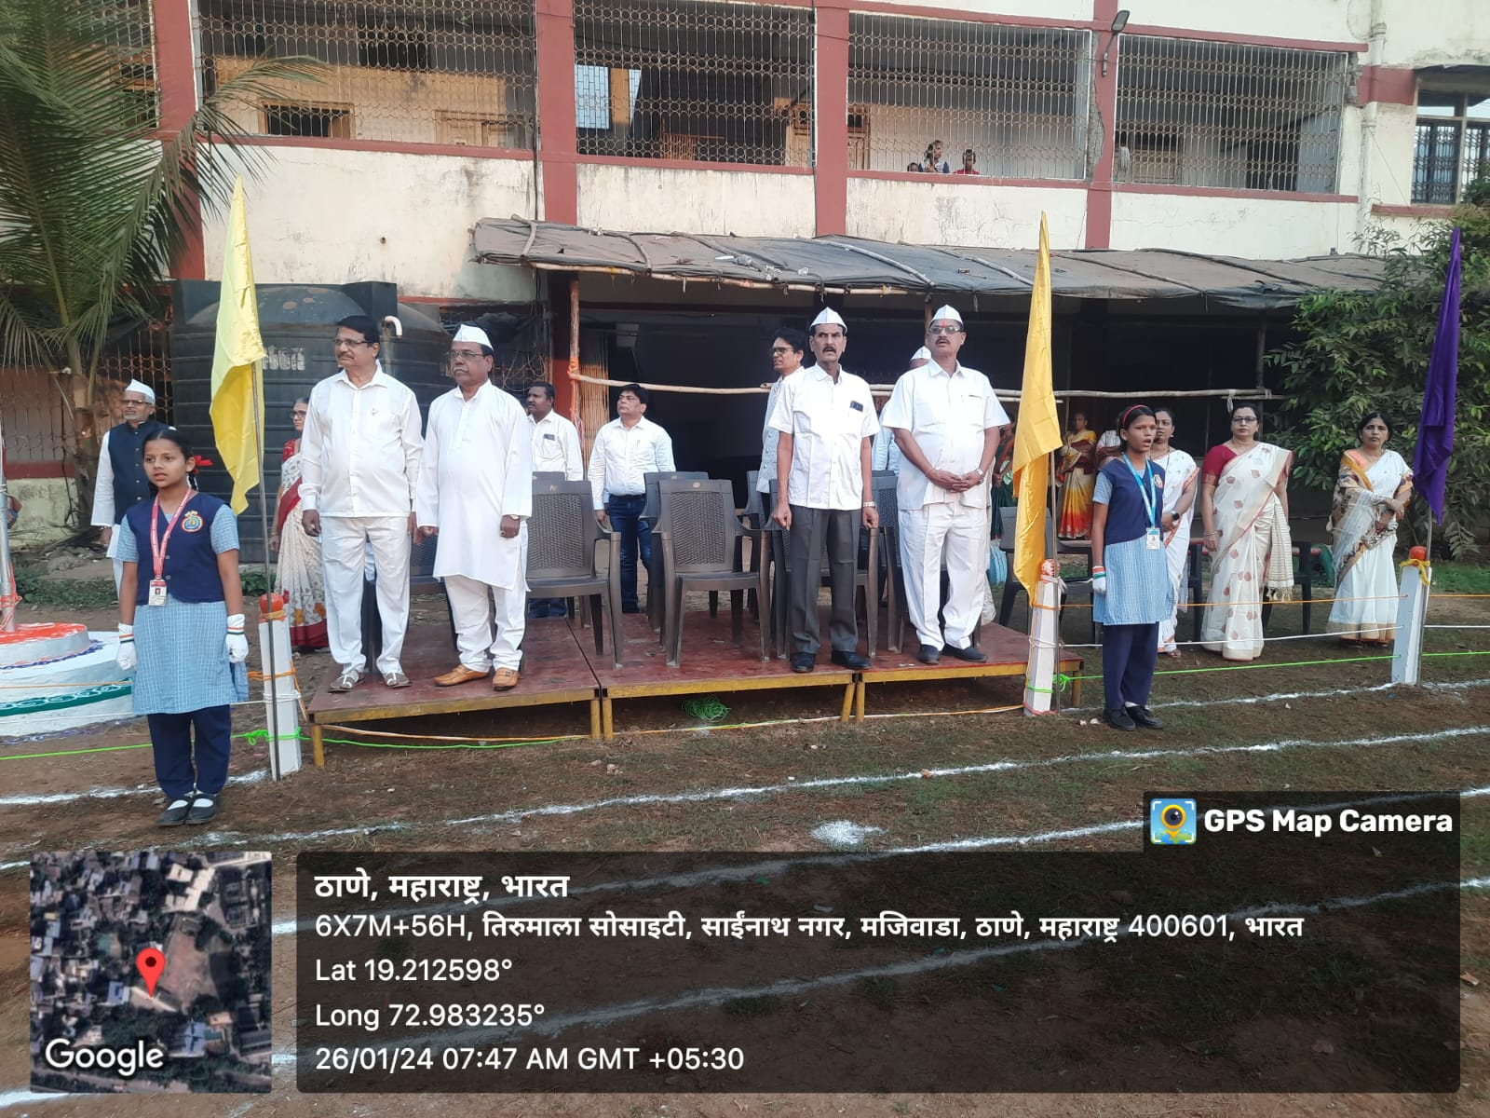
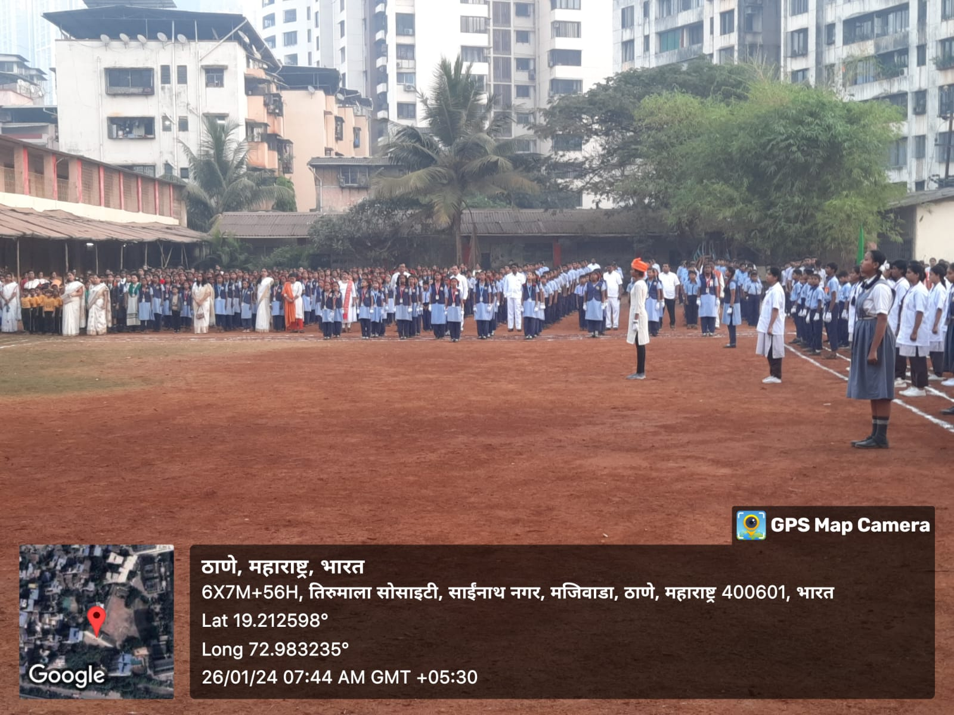
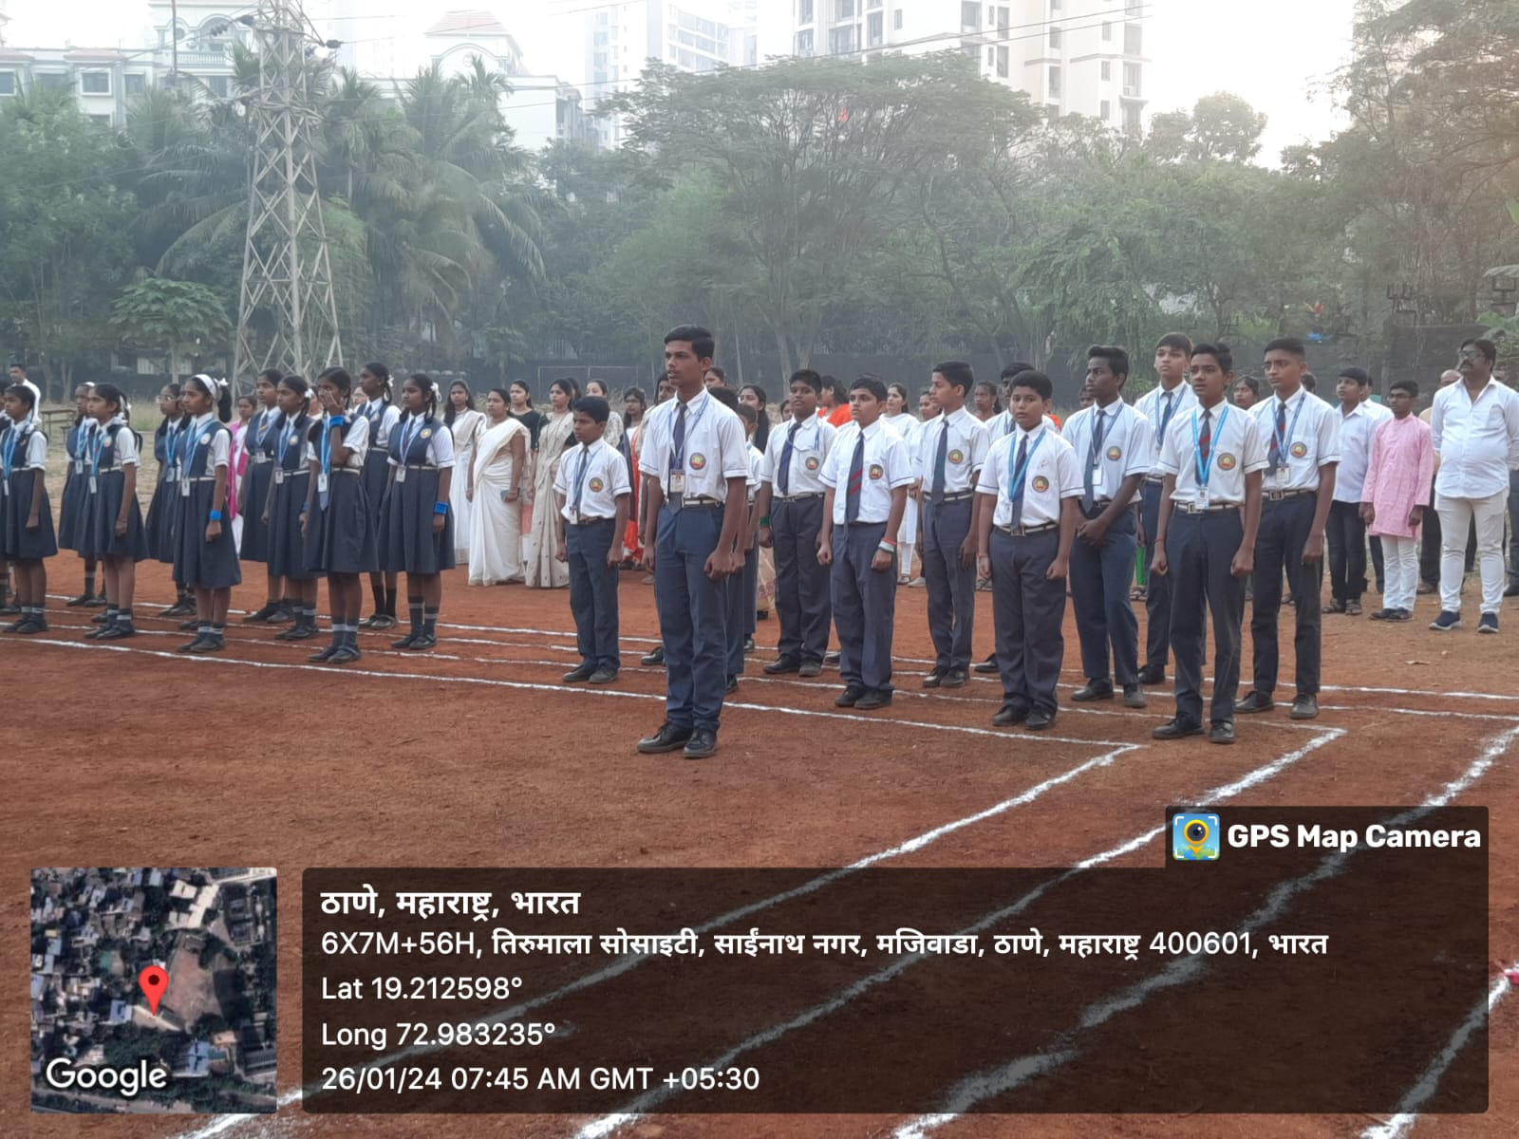
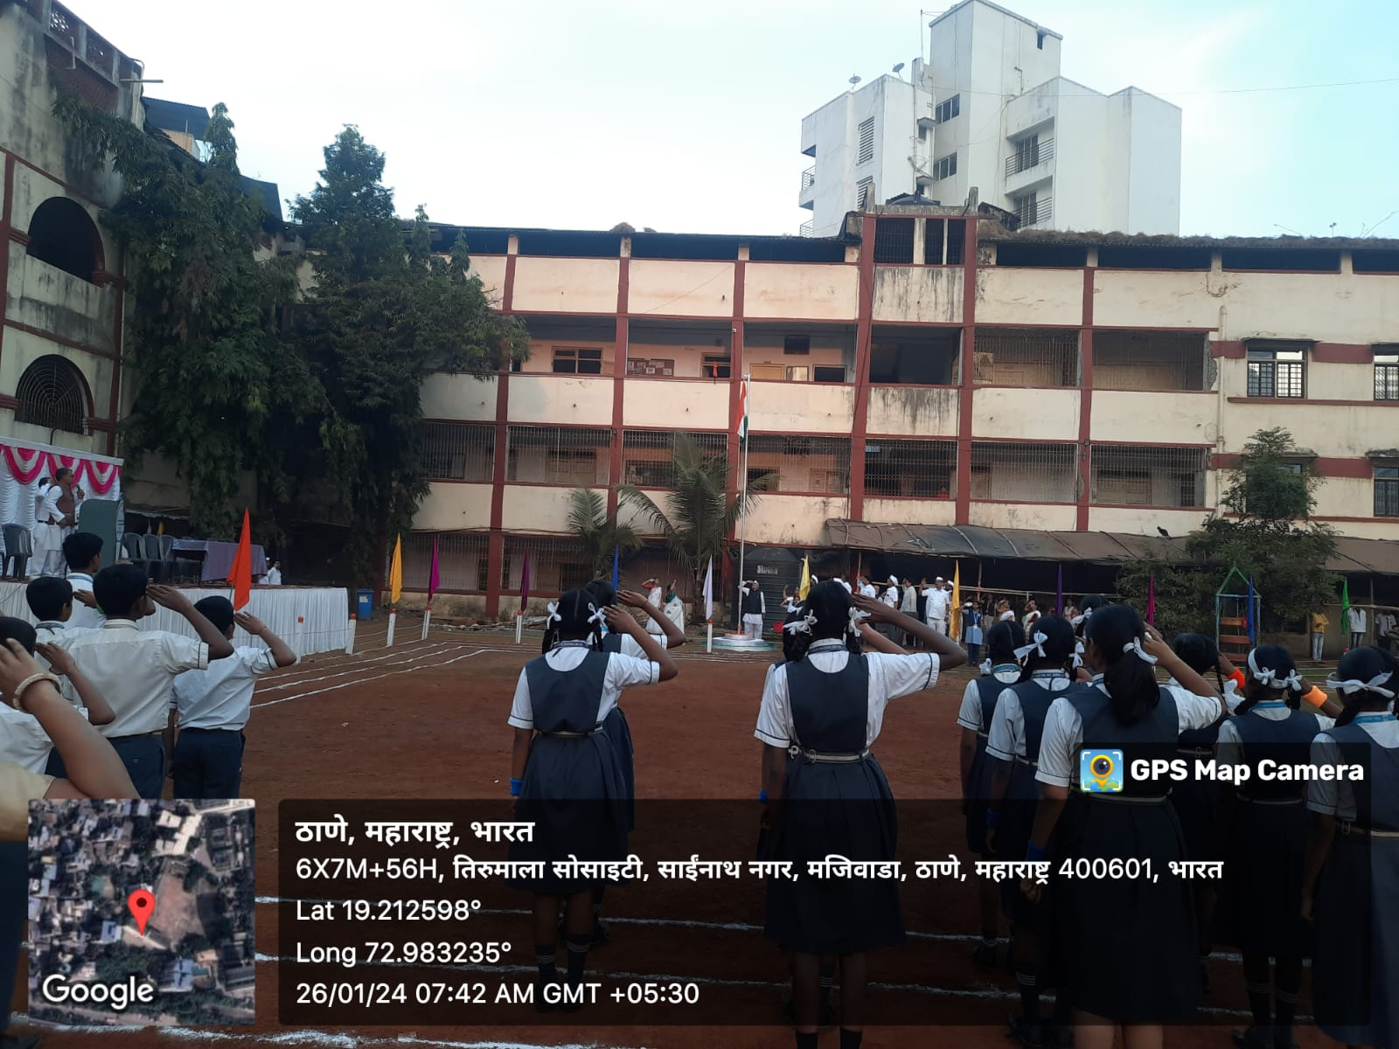
26 JAN REPUBLIC DAY 2023 - 24
Total Volunteers | No. of WorK Hours | No. of Benificiaries if any
32 | 4 | 300

Slide 12
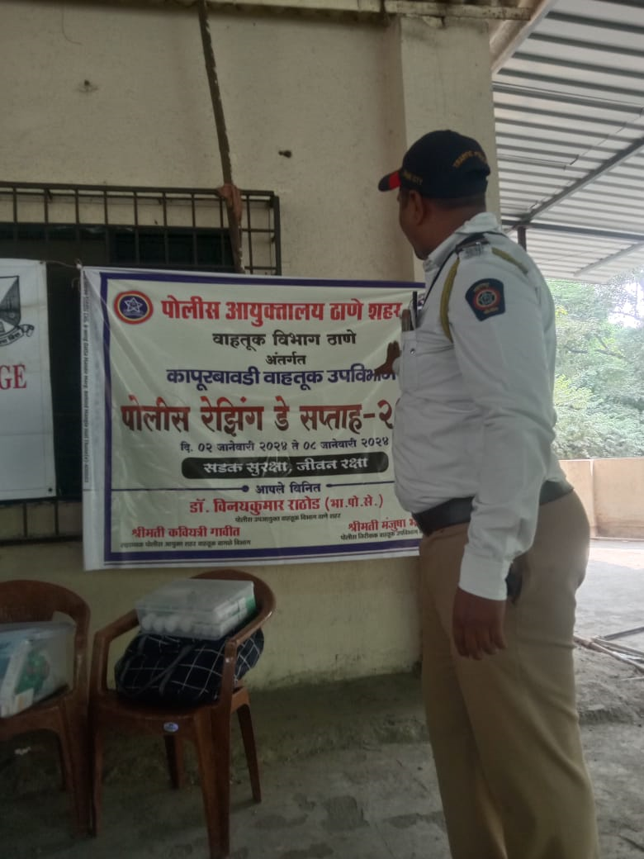
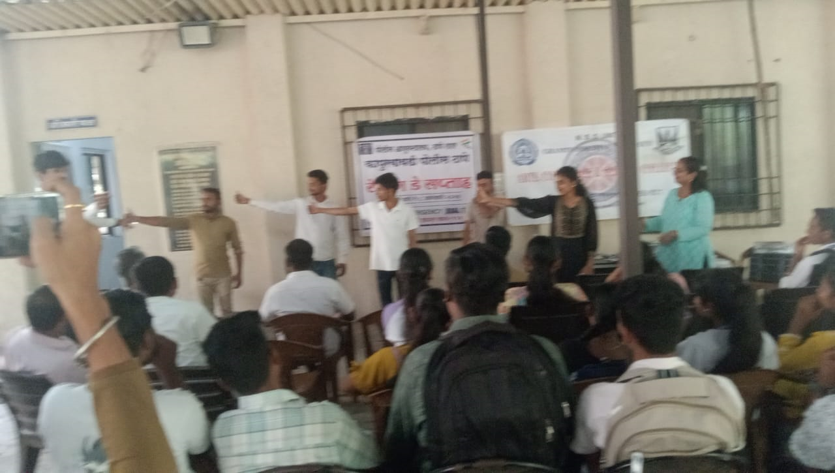
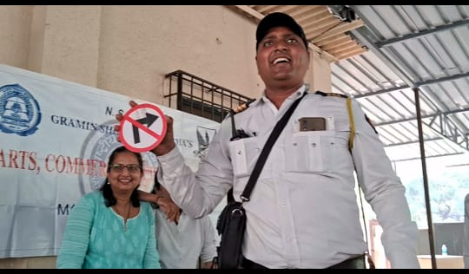
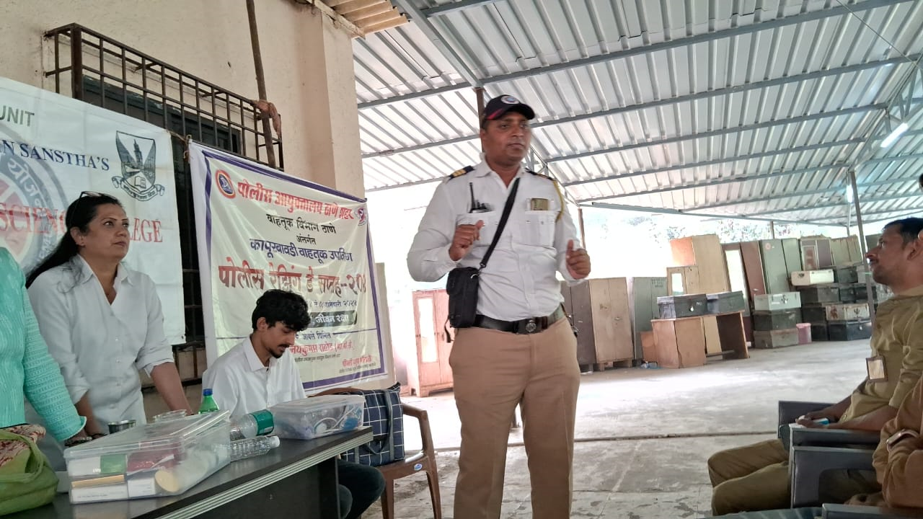
TRAFFIC RULES & REGULATION 26 JAN 2023-24
Total Volunteers | No. of WorK Hours | No. of Benificiaries if any
70 | 4 | 600

Slide 13
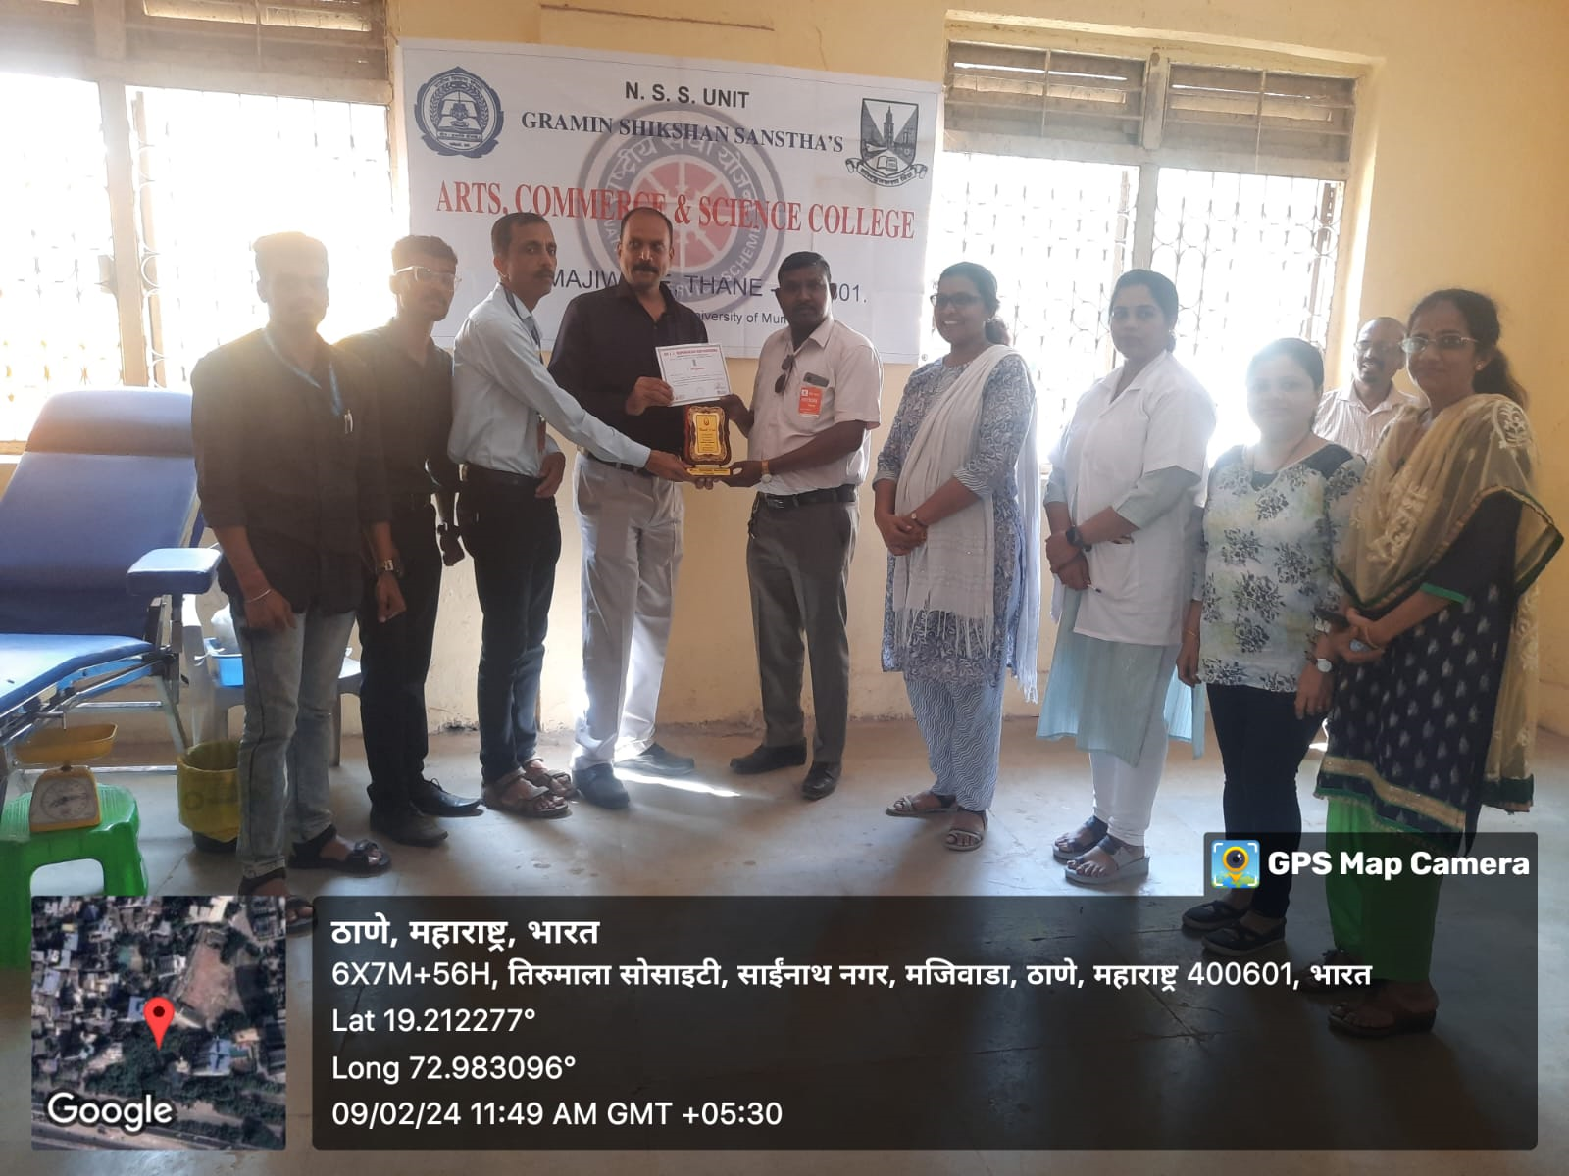
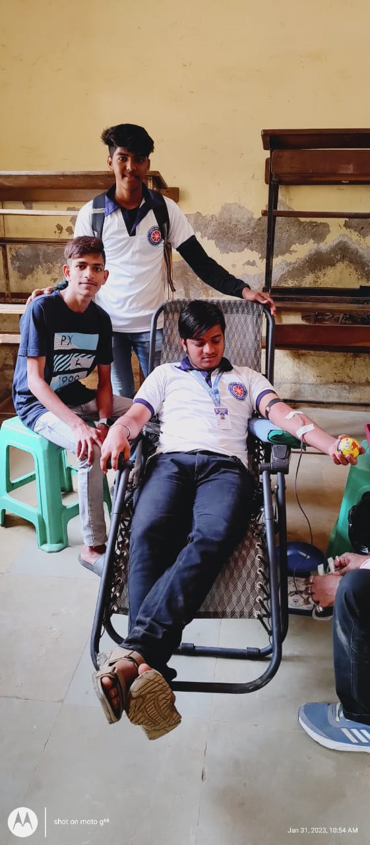
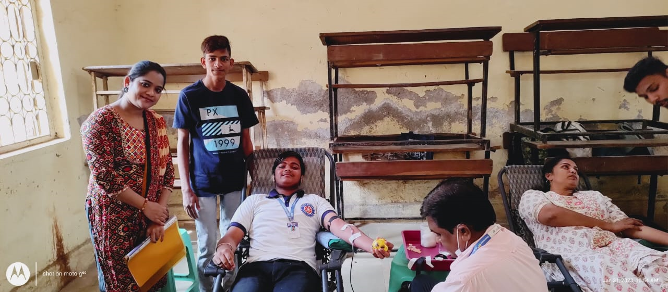
BLOOD DONATION & HEMOGLOBIN CHECK- UP CAMP 9 FEB 2024
Total Volunteers | No. of WorK Hours | No. of Benificiaries if any
45 | 4 | 450

Slide 14






SEVEN DAY RESIDENTIAL CAMP 12 FEB TO 18 FEB 2023-24
Total Volunteers | No.of WorK Hours | No. of Benificiaries if any
50 | 14 | 1000

